Slide 1
ENGR181W
Technical Communication and Documentation

Slide 2
MASTERING WHITE PAPERS
White Papers vs. Report
The Bridge Between Engineering Theory and Industrial Authority

Slide 3


SECTION 01
THE STRATEGIC IMPERATIVE

Slide 4
INDUSTRY INFLUENCE
84%
OF TECH B2B BUYERS
Consult white papers during the evaluation phase of complex electrical engineering systems. It is the gold standard for "Technical Trust."

Slide 5






CAREER APPLICATIONS FOR EE GRADUATES
R&D ENGINEER
FIELD APPS (FAE*)
PRODUCT MARKETING
Used to document new architectures and patent-adjacent research findings for stakeholders.
Bridging the gap between complex silicon features and customer implementation needs.
Translating technical specs into high-value business outcomes for executive buyers.
*Field Applications Engineer. An FAE is a hybrid technical-business role that acts as the bridge between a technology company (like a chip manufacturer) and its clients. .

Slide 6


BEYOND THE RESUME
ESTABLISHING AUTHORITY
As a graduating student, you lack years of experience.
A well-written white paper on your capstone project serves as objective proof of your technical depth and communication skills.
Showcases logical problem-solving.
Proves ability to handle complex data.
Differentiates you from thousands of applicants.

Slide 7

SECTION 02
DEFINING THE MEDIUM

Slide 8


WHAT IS A WHITE PAPER?
TECHNICAL GUIDE
EDUCATIONAL MARKETING
A data-driven document that defines a complex challenge and outlines a technical solution based on engineering principles.
It aims to persuade by informing. It does not "sell" features; it "validates" solutions through rigorous analysis.

Slide 9
WHITE PAPER VS RESEARCH PAPER
Feature | Academic Research Paper | Technical White Paper
Primary Goal | Advance academic knowledge. | Solve an industrial/business problem.
Tone | Highly theoretical & objective. | Persuasive & application-focused.
Data Focus | Novelty of research. | Reliability & efficiency in practice.
Audience | Peers & Professors. | Engineers & Decision-makers.

Slide 10
WHITE PAPER VS TECHNICAL MANUAL
TECHNICAL MANUALS
WHITE PAPERS
Focus: "How to use it."
Focus: "Why this solution works."
Functional descriptions.
Theoretical justification.
Non-persuasive.
Comparative analysis.

Slide 11
"Engineering is the art of organizing and directing men [humankind] and controlling the forces and materials of nature for the benefit of the human race."
Henry G. Stott, IEEE President 1907

Slide 12

SECTION 03
ANATOMY & STRUCTURE

Slide 13
THE 6-STEP LAYOUT STRUCTURE
EXECUTIVE SUMMARY
PROBLEM STATEMENT
TECH BACKGROUND
METHODOLOGY
RESULTS
CTA

Slide 14
TITLE & EXECUTIVE SUMMARY
THE "HOOK" TITLE
THE SUMMARY
Avoid: "A Study on Buck Converters."
A 250-word snapshot of the problem, the specific engineering innovation, and the quantified result (e.g., "95% efficiency achieved").
Use: "Optimizing Efficiency in Low-Voltage Buck Converters for Automotive IoT Applications."

Slide 15


DEFINING THE CHALLENGE
THE PROBLEM STATEMENT
Great white papers begin with a pain point.
In EE, this is usually a limitation of current technology (thermal constraints, latency, noise, or cost).
Establish Urgency: What happens if this problem isn't solved? (e.g., data corruption in high-speed signaling).

Slide 16
THE TECHNICAL FOUNDATION
BACKGROUND & CONTEXT
Before presenting your solution, educate the reader on the current landscape.
Reference industry standards (IEEE, CISPR).
Acknowledge existing methodologies.
Identify the "Gap" your work fills.

Slide 17

THE METHODOLOGY
This is where your engineering consistency shines.
Describe your design flow, circuit topology, and simulation parameters.
Use schematics and flowcharts to reduce cognitive load on the reader.
Words explain the 'why'; visuals explain the 'how'.

Slide 18
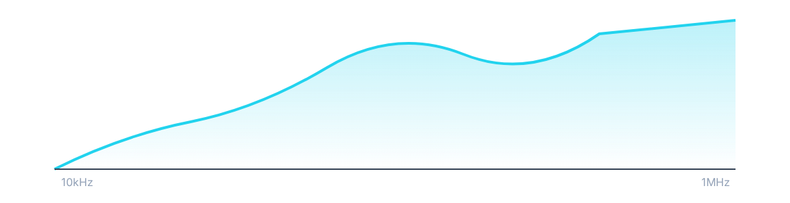
VALIDATION THROUGH DATA
EFFICIENCY VS FREQUENCY RESPONSE
Figure 1: Comparative Analysis of Switching Loss (dB)

Slide 19




CONCLUSION & CTA
SYNTHESIS
THE CTA
Summarize how the data supports the original problem statement.
Guide the reader. Should they download an Altium file?
Request a dev kit? Contact R&D?

Slide 20

SECTION 04
REAL-WORLD EE EXAMPLES

Slide 21
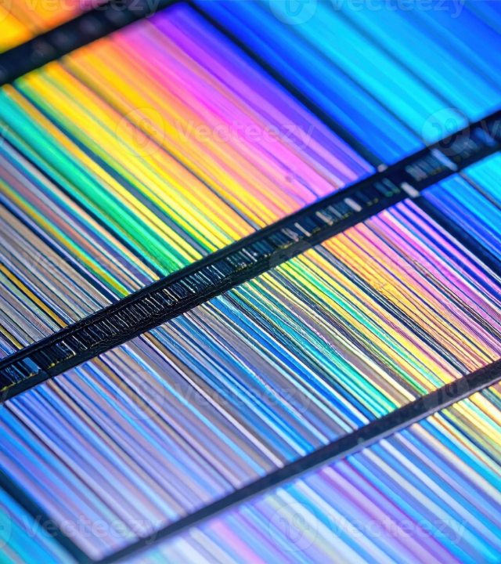
EXAMPLE 1: SEMICONDUCTOR
Topic: GaN (Gallium Nitride) Power Density.
Companies like TI or Infineon* use white papers to prove that GaN allows for 3x higher power density in chargers compared to Silicon.
The "Proof" usually includes thermal imaging and size comparisons.
*Texas Instruments (TI) and Infineon Technologies

Slide 22
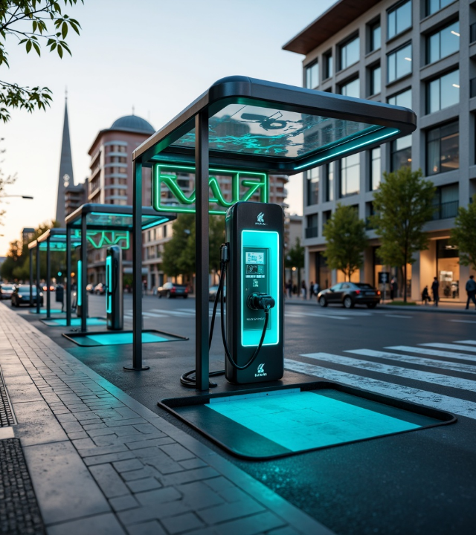
EXAMPLE 2: POWER GRID
Topic: EV Fast Charging Challenges.
Siemens publishes papers on how ultra-fast charging stations (350kW+) impact local grid stability and the role of stationary battery storage in buffering load spikes.

Slide 23

EXAMPLE 3: IOT & COMM
Topic: LPWAN* (LoRaWAN) for Smart Cities.
White papers focus on signal penetration in dense urban environments and the trade-offs between data rate and range in sub-GHz bands.
*LPWAN = Low-Power Wide-Area Network

Slide 24

EXAMPLE 4: AI & EDGE
Topic: Neural Processing Units (NPUs).
Silicon vendors like ARM or Synopsys demonstrate how specialized hardware accelerators reduce TOPS/Watt* for vision processing at the edge.
*TOPS (Tera Operations Per Second)

Slide 25

SECTION 05
THE GRADUATE'S ROADMAP

Slide 26


YOUR CAPSTONE AS A PAPER
MINING YOUR PROJECT
Don't let your final year project gather dust on a shelf. Convert your technical report into a professional white paper.
Focus on the Engineering Decisions: Why did you choose a MOSFET over an IGBT*? Why that specific filtering topology?
*Insulated-Gate Bipolar Transistor

Slide 27
BUILDING A PORTFOLIO
Host your white papers on LinkedIn or a personal GitHub/Portfolio site.
Send relevant papers ahead of interviews as "technical pre-reading."
Target niche communities (EEVblog, IEEE Xplore, specific LinkedIn groups).

Slide 28


LEADERSHIP THROUGH WRITING
INTERNAL ADVOCATE
CONFERENCE PREP
Use white papers to justify new tech stack choices to your future boss.
A white paper is the perfect foundation for a conference talk or poster.

Slide 29

SECTION 06
DESIGN & VISUALS

Slide 30
VISUALIZING COMPLEXITY
A white paper is not a novel.
It should be skimmable.
If a section takes more than 3 paragraphs without a visual, you are losing the reader.
Use Callouts for Key Findings: Place critical statistics and achievements in boxed callouts to draw the reader’s attention.

Slide 31
DESIGN PRINCIPLES
TYPOGRAPHY
WHITE SPACE
Do not crowd the page.
Engineering is precise; your layout should reflect that precision through clean margins and balance.
Use Sans-Serif for readability.
Use Monospace for code/math.
Consistent hierarchy (H1, H2).

Slide 32

SECTION 07
EXECUTION & PITFALLS

Slide 33
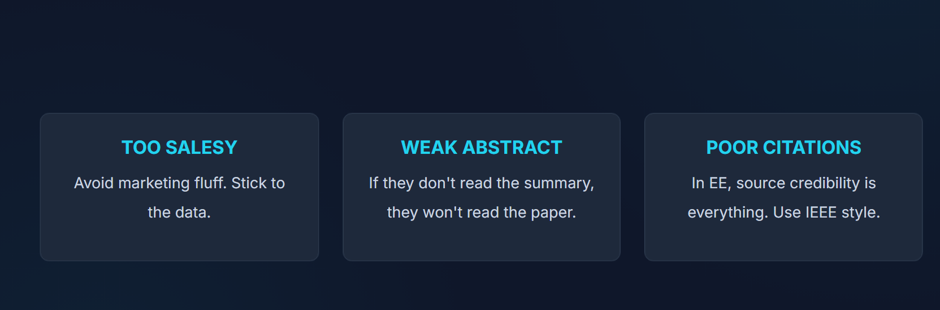
TOP DRAFTING MISTAKES

Slide 34

CONCLUSION
Start writing today. Your career depends on it.

